Slide 1



Public Transport Efficiency And Analysis
Presented By
Ebinesh.B

Slide 2
CONTENTS
Introduction
Urban Mobility Trends
Ridership Analysis
On-Time Performance
Cost Analysis
Environmental Impact
Accessibility and Inclusivity

Slide 3
INTRODUCTION
Brief overview of the importance of efficient public transportation in urban areas.
Highlight the challenges and benefits.

Slide 4
URBAN MOBILITY TRENDS
Graphs or charts showing the increasing urbanization and the need for efficient transportation systems.
Electrification. The extinction of thermal vehicles and restriction or a ban on access to cities. Redefining urban spaces with a view to prioritizing walking or cycling

Slide 5


Slide 6
RIDERSHIP ANALYSIS
Graphs depicting ridership trends over time.
Factors influencing ridership (e.g., population growth, economic factors, etc.).
The Public Transportation Ridership Report is a quarterly report of transit passenger ridership for U.S. And Canadian transit agencies. The report includes quarterly and year-to-date estimated unlinked transit passenger trips for the current and previous year by transit mode.

Slide 7
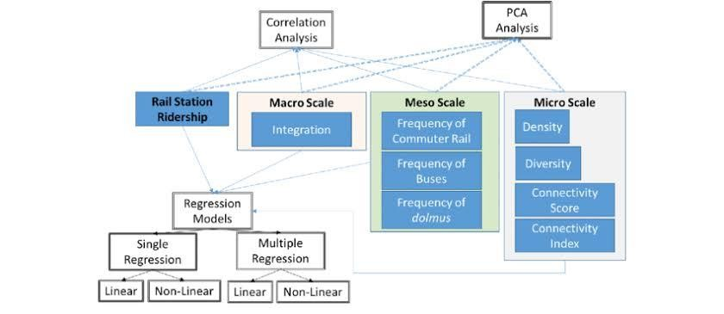

Slide 8
ON-TIME PERFORMANCE
Graphs or charts showing the punctuality of public transportation services.
Discuss factors affecting on-time performance (e.g., traffic congestion, maintenance issues, etc.).

Slide 9
COST ANALYSIS
Breakdown of costs associated with public transportation operations.
Comparison of different modes (e.g., bus, subway, tram, etc.).
The process of calculating the potential earnings from a situation or project and subtracting the total cost associated with completing

Slide 10
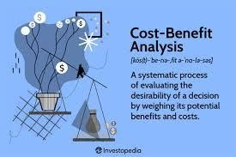

Slide 11
ENVIORNMENT IMPACT
Information on how public transportation can reduce carbon emissions and promote sustainability.
Use charts or graphs to illustrate the environmental benefits.

Slide 12
ACCESSIBILITY AND INCLUSIVITY
Discuss efforts made to ensure accessibility for all passengers, including those with disabilities.
Show examples of inclusive features (e.g., ramps, audio announcements, etc.).

